Slide 1
Hard disk
Michael 3778
Kevin 3894
Garry 3769

Slide 2
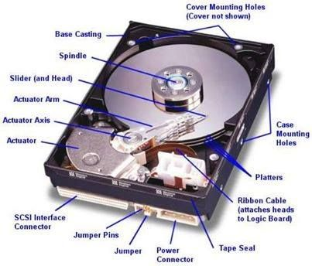
What is a hard disk
- data stored in logical blocks
- often sized 512 bytes per block
- nowadays advanced knowledge increases to 4096 bytes per block

Slide 3
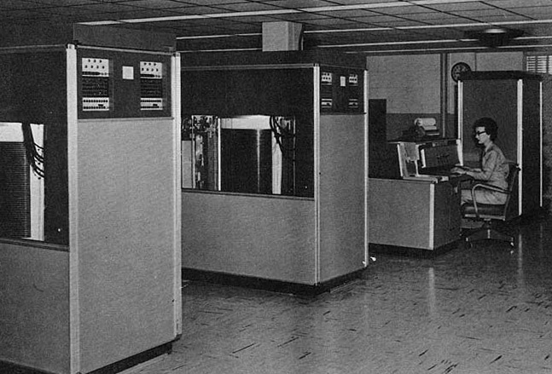
History of hard disk
First hard disk made by IBM in 1956, named RAMAC
RAMAC had storage of 5MB
By that time 5MB was way more than one’s needs

Slide 4
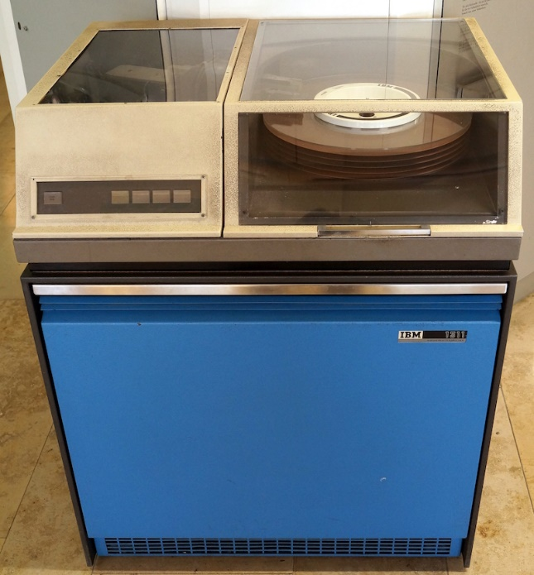
History of hard disk
In 1962, IBM1311
Data Storage drive introduced First removable storage

Slide 5
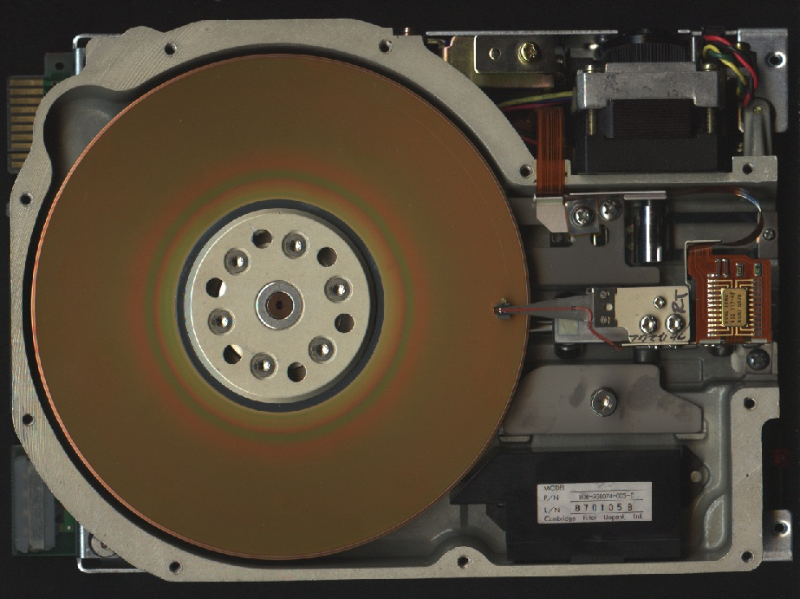
The structure of hard disk
In 1980, Shugart Technology invented 5MB Hard drive which can fit into PC

Slide 6
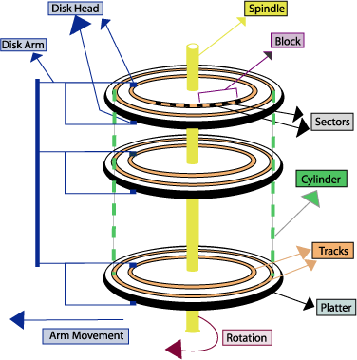
The structure of hard disk
Platters are made from a hard material such as glass or aluminum, which is coated with a thin layer of metal that can be magnetized or demagnetized
Track
Cylinder

Slide 7
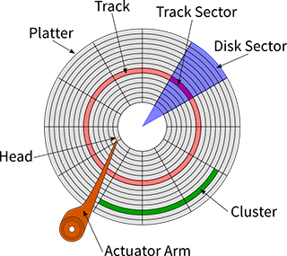
Sector
a sector is a subdivision of a track on a magnetic disk or optical disc. Each sector stores a fixed amount of user-accessible data, traditionally 512 bytes for hard disk drives (HDDs) and 2048 bytes for CD-ROMs and DVD-ROMs. Newer HDDs use 4096-byte (4 KiB) sectors, which are known as the Advanced Format (AF)

Slide 8
How does hard disc work
Modern hard discs uses magnetic recording to change the direction of magnetization on the disk in order to store bits of data sequentially.
This process is done by the magnetic head
The disk spin at either 5400 rpm or 7200 rpm
in most consumer-grade
If your computer has a 20 gigabyte (GB) hard drive, or you have a 20 GB iPod or MP3 player, it's a bit like a box containing 160 thousand million microscopically small iron nails

Slide 9
Defragmentation

Slide 10
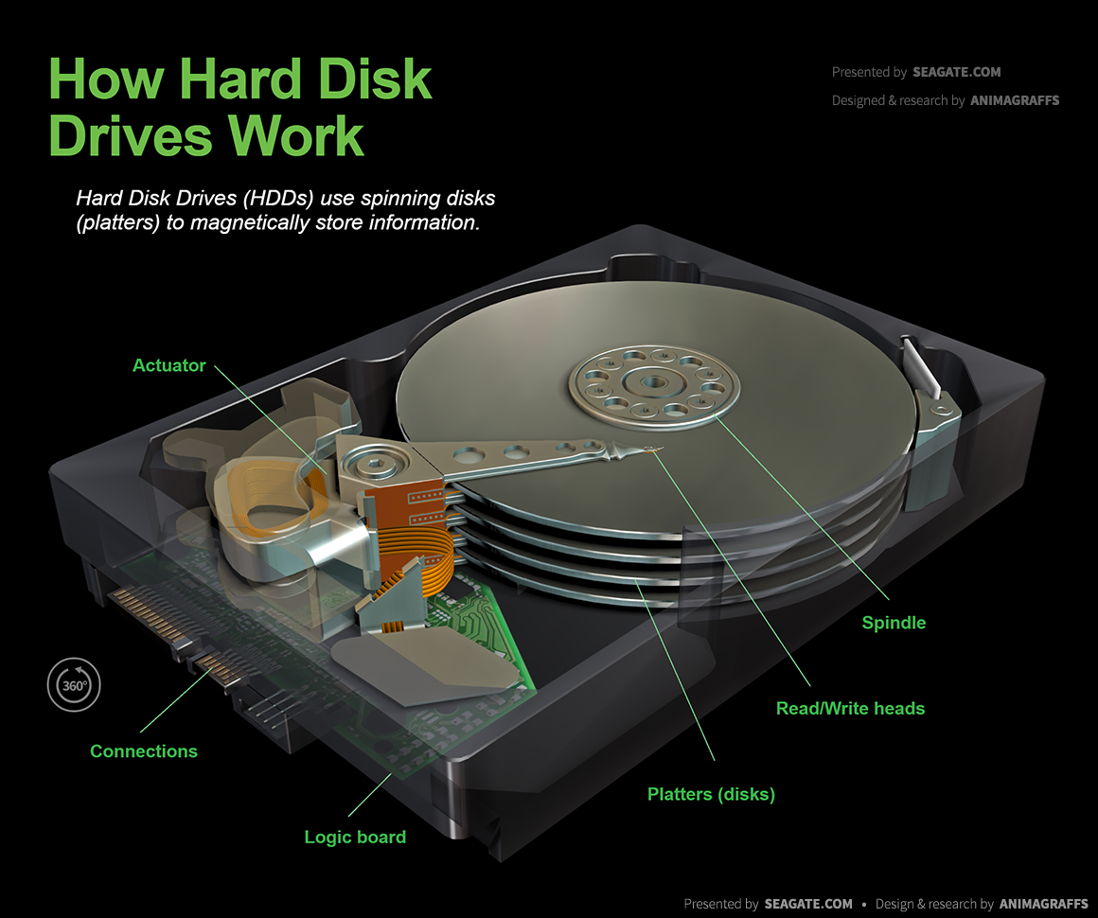
How does hard disk work
The disk is separated into many small layers, each layer has a magnetic head in order to write/read

Slide 11
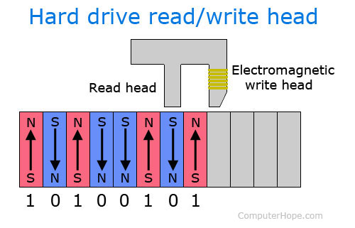
Reading and writing data

Slide 12
Thanks for watching
All pictures and information came from the internet

